Slide 1
Price and Output Determination in Monopoly Markets
Student’s Name
Institutional Affiliation
Date

Slide 2
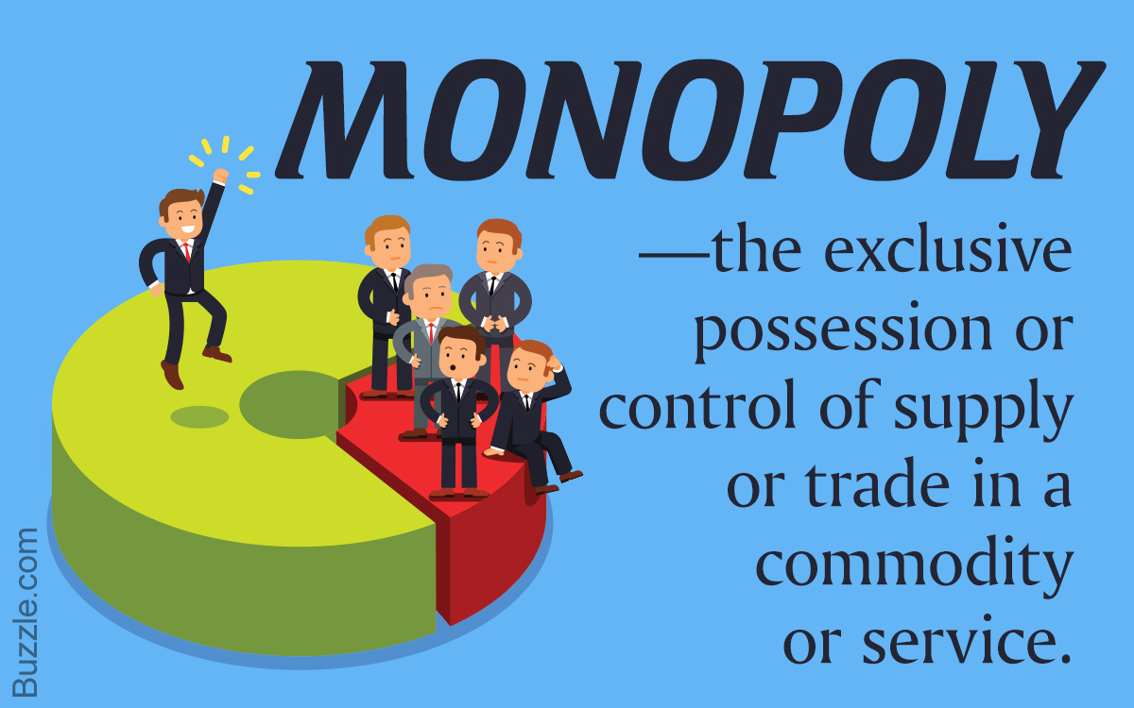
Introduction
A monopoly is a market structure consisting of a single seller who controls the market.
Sold products have no close substitutes but have direct demand, supply, and product price.
Price determination is based on the willingness of the firm to sell (Bertoletti & Etro, 2017).
Previous studies shed more light on price, output determination, market power and price discrimination.
Notes:
Price determination among monopolies tend to incline toward price discrimination as firms opt to sell their products or services at different markets in different prices to maximize their profits (Bertoletti & Etro, 2017). As such, monopolies are the only producer of a product. This make them to influence the price of the product by changing the supply.

Slide 3
Price and Output Determination
Monopolies determine the prices of their products independently.
Simple pricing rules and closed-form solutions can be put in place to regulate the pricing of monopolies (Cowan, 2018).
Price discrimination might occur when individual firms try to maximize their profits as they set different prices depending on the market.
Defining monopolistic competition based on the market structure is insignificant (Jim & Scaramozzino, 2017).
Notes:
Price determination is a critical aspect among monopolies since they get to dictate the market share and profits to be realized (Jim & Scaramozzino, 2017). Monopolies study the market based on what other businesses determine prices in order to make profits. In addition, closed-form solutions and simple pricing rules emerged under monopolistic competition when common aggregators determined the demands (Cowan, 2018).

Slide 4
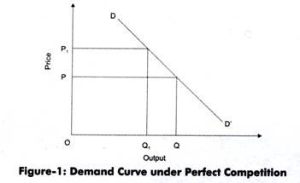
Price and Output Determination (Cont..)
Price determination can be controlled when firms with market power set a profit margin in every market.
A regulator may also be used to determine the level of the margin based on the average of initial margins (Fanti & Buccella, 2017).
With such a rules in place, social welfare can be realized, hence protecting the consumer.
Price determination can influence the market share of the individual firm (Watson & Ziv, 2019).
Notes:
For intermediate goods across resale markets, price determination can be managed by eliminating practices like dual wholesale pricing and increasing overall sales in the long run (Fanti & Buccella, 2017). The use of regulators may also be used to determine the level of the margin based on the average of initial margins. This can also dictate setting of margins (Watson & Ziv, 2019).

Slide 5
Price Discrimination and Output Determination
Price discrimination might be minimal to affirm with market power (Laussel & Resende, 2019).
Regulators may determine the level of the margin based on an average of the initial margins.
Simple regulation forms of the structure and level of monopolistic prices may lead to interests.
Equal margins increase consumer surplus when the firm initially sets an equal price though costs may differ (Miklós-Thal & Shaffer, 2019).
Notes:
Price discrimination is a pricing strategy used by monopolies as they allow identical goods or services to be transacted by the same provider at different prices in different markets (Laussel & Resende, 2019). Price discrimination might be minimal to affirm with market power to succeed in achieving the set profits. The use of regulators may essential in the determination of the level margins. Most monopolies have more than 50% of the market share, and as such, this might force the consumers to adhere to price discrimination imposed by the monopoly (Miklós-Thal & Shaffer, 2019).

Slide 6
Sources of Monopoly Power (Cont..)
Land ownership, on the other hand, also creates monopoly as the owners set their own rent prices thus dictating the market power.
Zoning regulations can be used to create spillovers through increased markups hence establishing conditions that can restrict concentration of land ownership and reduce rents (Watson & Oren, 2019).
Zoning regulations can create spill overs via increased mark-ups and also establish conditions.
Market power is substantial and it averagely account for 21% of the rent (Jim & Scaramozzino, 2017).
Notes:
Land monopoly is not just a monopoly but the greatest and the mother of all monopolies due to its perpetual nature. According to Watson & Oren (2019), inequality is closely linked to the rising monopoly power. This can be shown by the use of a general equilibrium model involving firms with rising monopoly power and finds based on how they enjoy market power (Jim & Scaramozzino, 2017).

Slide 7

Sources of Monopoly Power
Firms can acquire their monopoly powers through intellectual properties or ownership of land.
Intellectual property is often patented, hence allowing the owner to take advantage and maximize profits.
Barriers to entry are enforced to monopolize the owner of the patent.
Innovation can be stimulated by promoting intellectual rights and supporting R & D among individual firms (Kurz, 2017).
Notes:
IT driven firms often take advantage of intellectual rights to create monopolies through barriers of entry hence creating inequalities as they accumulate wealth. Another source of monopoly power can be land ownership, which is perceived as a perpetual monopoly due to its permanent nature. Monopolist landowners are known to maximize profits by setting rents hence dictating their market power (Kurz, 2017).

Slide 8

Upstream and Downstream Monopolies
Upstream and downstream monopolists produce complementary inputs independently.
Bilateral monopoly model can be implemented to maximize profits (Spulber, 2017).
The final demand can influence the critical interaction between upstream and downstream monopolists who produce complementary inputs independently.
Complementary-input monopolies may also help in achieving joint maximization of profits (Sun et al., 2017).
Notes:
Both upstream and downstream monopolists who produce complementary inputs independently (Spulber, 2017). Monopolies practice price discrimination for them to be able to transact similar goods or service at different prices in different markets. Monopolistic firms tend to engage in price discrimination to maximize their profits and this can be regarded as an aspect of achieving competitive advantage (Sun et al., 2017).

Slide 9
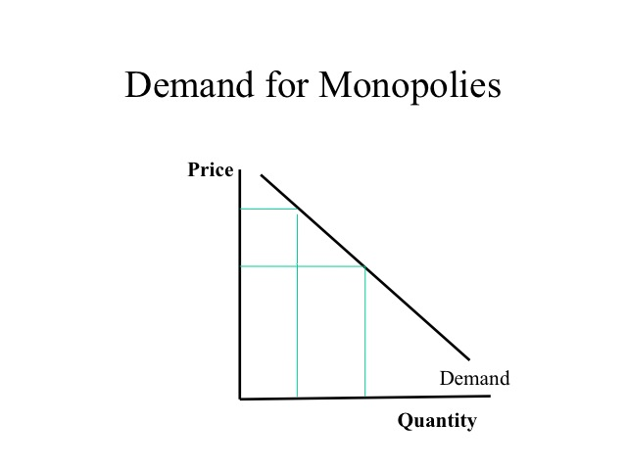
Conclusion
Price determination for monopolies is determined independently.
Multiple monopolies embrace price discrimination to maximize profits.
Sources of monopoly powers are can gained through intellectual rights and land ownership.
Firms use their market power to set profit margins.

Slide 10
References
Bertoletti, P., & Etro, F. (2017). Monopolistic competition, as you like it. University Ca'Foscari of Venice, Dept. of Economics Research Paper Series No, 8.
Cowan, S. (2018). Regulating monopoly price discrimination. Journal of Regulatory Economics, 54(1), 1-13.
Fanti, L., & Buccella, D. (2017). Bargaining agenda in a unionised monopoly with network effects: when corporate social responsibility may be welfare-reducing. EconomiaPolitica, 34(3), 471-489.
Jim, H. S., & Scaramozzino, P. (2017). A bilateral monopoly model of profit sharing along the global supply chain. In Forum For Research in Empirical International Trade Working Paper Series (No. 1252).
Kurz, M. (2017). On the formation of capital and wealth: IT, monopoly power and rising inequality. Monopoly Power and Rising Inequality (June 25, 2017).
Laussel, D., &Resende, J. (2019). Complementary Monopolies with asymmetric information. Economic Theory, 1-39.
Miklós-Thal, J., & Shaffer, G. (2019). Input price discrimination by resale market. Available at SSRN 3191951.
Spulber, D. F. (2017). Complementary monopolies and bargaining. The Journal of Law and Economics, 60(1), 29-74.
Sun, B., Jing, W., Zhao, X., & He, Y. (2017). Research on market power and market structure. International Journal of Crowd Science.
Watson, C. L., & Ziv, O. (2019). Is the Rent Too High? Land Ownership and Monopoly Power.

